Slide 1

Reinforcement Learning
Course Policy
Hongning Wang
CS@THU
https://coai.cs.tsinghua.edu.cn/Courses/RL2025/_site/

Slide 2

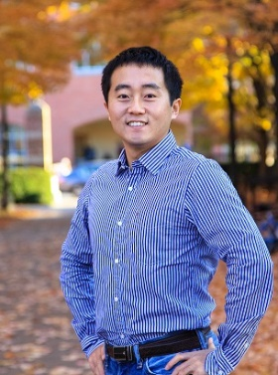
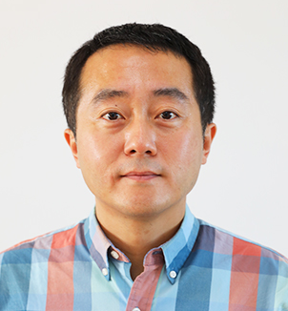
Instructor
Hongning Wang
  BE and ME from Tsinghua, in 2007 and 2009
  PhD from the University of Illinois at Urbana-Champaign in 2014
  Faculty member at the University of Virginia, until 2023
  Faculty member at Tsinghua, since 2023

Slide 3

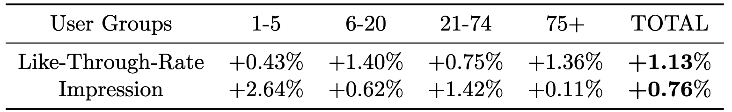
Instructor
Hongning Wang
  Research area
    Information retrieval
    Large language models
    Machine learning
  Industry experience
    Google
    Microsoft Research
    Meta
    ByteDance/KuaiShou
My main application areas of reinforcement learning
  A/B test: randomly pair 3% creators with 3% users from the entire platform for each trial

Slide 4
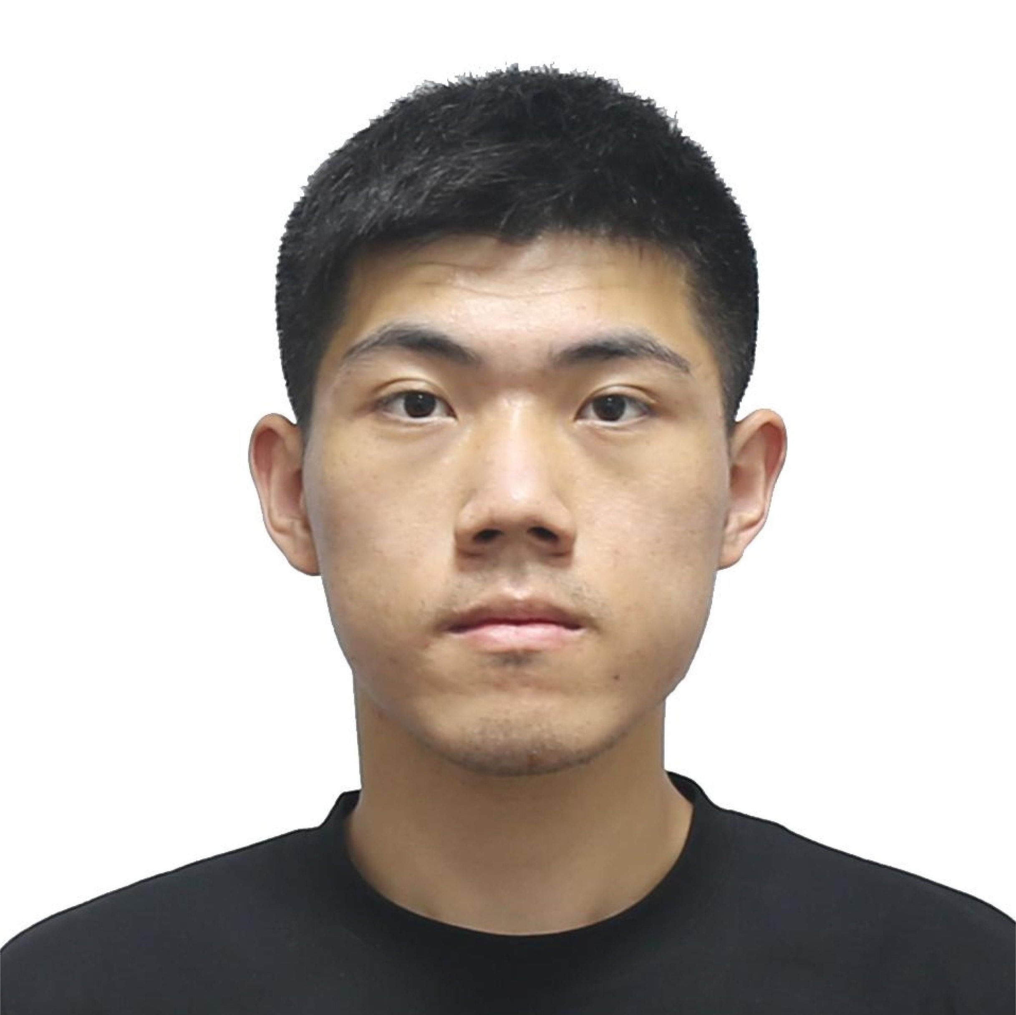
Teaching assistant
Xujun Li (lixujun20@gmail.com)
  Research area
    Reinforcement learning
    Large language models

Slide 5
How about you?
Why do you choose this course?

Slide 6
Course delivery
In-person and lecture-based
  Time: Friday, 3:20 to 4:55pm
  Location: 四教4104
  Office hours
    Instructor: Monday 4-5pm, FIT 3-520
    TA: Tuesday 11am-12pm, FIT 4-504
    Please make an appointment 24 hours beforehand
    Additional appointments can be requested via email

Slide 7

Character of this course
Discussion oriented and heavy
  This is how great ideas are created!
  You are encouraged to express your thoughts, confusions, and suggestions
  Focusing on why, rather than just how

Slide 8

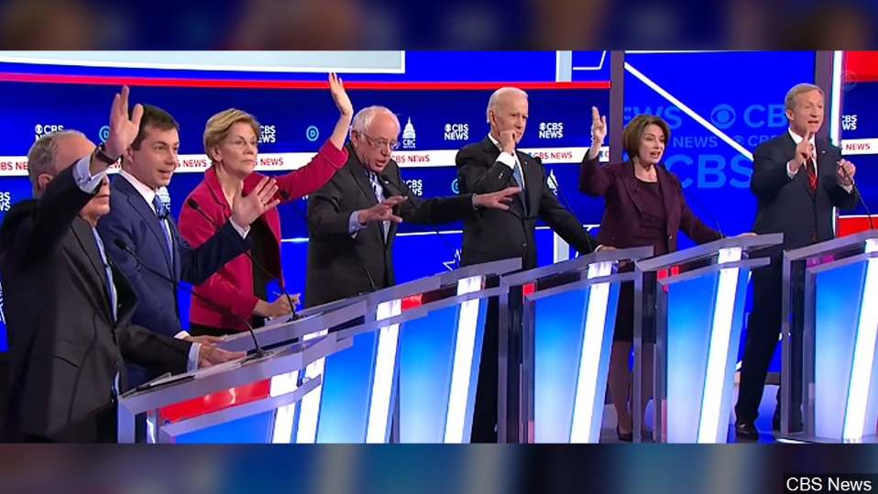

Classroom participation
HIGHLY APPRECIATED!
  Helps me quickly remember your names
  Reminds me what is still confusing
  You should drive the lecture/discussion in this class!

Slide 9

Positioning of this course
An introductory course about reinforcement learning
  Can hardly cover everything (new) in reinforcement learning
We have strong (pre-)assumptions
  You already have solid background in math and computer programming, and know machine learning to some degree

Slide 10

Pop-up quiz - math
If $x∼N(0,σ^{2})$, what is $Var[x^{2}]$?
Is $log\left(\sum_{i=1}^{m}{e^{θ^{T}x_{i}} }\right)$concave or convex in $θ$?
For matrix $A_{m×n}$, given its rank is $k$, what is the rank of $A^{⊤}A$, and how about $AA^{⊤}$?

Slide 11
Pop-up quiz - programming
What is the time complexity of using dynamic programming to find the longest common subsequence between two sequences? How about its space complexity?
What is the time complexity of the insertion operation in a binary search tree?
How can we make matrix multiplication faster than simply looping through the rows and columns?

Slide 12
Pop-up quiz - ML
What is the so-called “variance-bias trade-off”?
What is the so-called “vanishing/exploding gradient” problem in neural networks? How should we address it?
Can L2 regularization make your solution sparse? And why?
Does stochastic gradient descent converge faster than gradient descent for a convex problem?

Slide 13
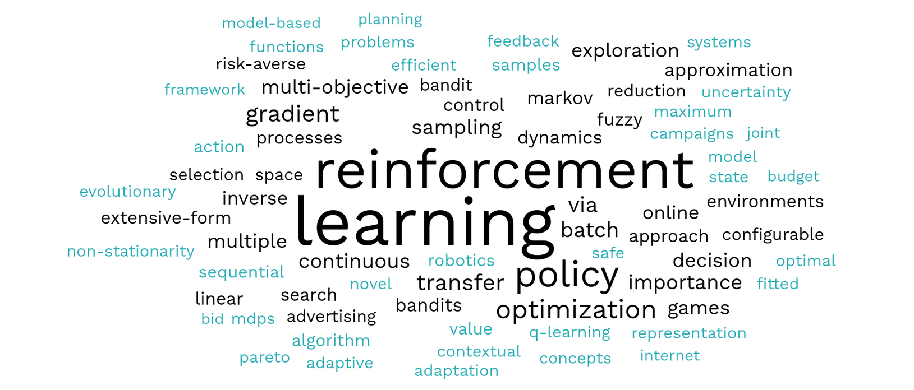
Positioning of this course
You do NOT need to have good familiarity with reinforcement learning
  Can you name any reinforcement learning algorithms?

Slide 14
Goal of this course
Discuss fundamental problems and state-of-the-art solutions in reinforcement learning
  Wide coverage of important reinforcement learning techniques
Get hands-on experience by solving practical problems
Prepare students for doing cutting-edge research in reinforcement learning and related fields

Slide 15
Structure of this course
Nine major topics will be covered by lectures
  Multi-armed bandit (~1.5 weeks)
  Markov decision process (~1 week)
  Dynamic programming (~1.5 weeks)
  Monte Carlo methods (~1.5 weeks)
  Temporal-Difference learning (~2 weeks)
  Policy gradient methods (~2 weeks)
  Approximation methods (~1 week)
  Deep reinforcement learning (~2 weeks)

Slide 16


Textbook
Reinforcement Learning: An Introduction
  Second Edition
  By Richard S. Sutton and Andrew G. Barto, MIT Press

Slide 17

Assessment
Homework (40%)
  Machine problems (4)
In-class quizzes (20%, 4)
  True/False, multiple choices, short answers
Course project (40%)
  Last week of semester
  Performed in groups
fairness will be guaranteed by the instructor
No curving will be applied!

Slide 18
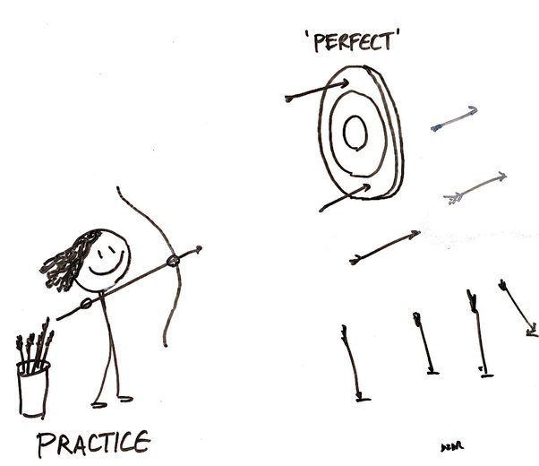
Machine problems
To be finished by each student individually
  One week for each assignment
  Sharing implementations is not allowed
  Discussions with your peers are encouraged

Slide 19

In-Class Quizzes
Closed-book
  15 minutes each
  Date will be announced one week ahead
  Non-overlapping coverage of content discussed in our lectures

Slide 20
Course project
Topics
  You have the full freedom; but convince your peers and instructor first!
Teamwork
  2-3 students per group
Evaluation
  Proposal: maximum 3 pages (15%)
  15-minutes in-class presentation (50%)
  Written report: maximum 6 pages (35%)
In required templates!

Slide 21

Course project
Team formation
  Post your sales pitch on our course forum and WeChat group to find your teammates before Oct. 11th
    Explain why we should be excited about your idea
    Required for everyone

Slide 22

Late policy
Homework
  Submit via 网络学堂
  Grace period
    You have free 4 late days in total for all assignments.
    You can use late days for any assignments. A late day extends the deadline 24 hours.
    Once you have used all 4 late days, the penalty is 10% for each additional late day (until 0 point left).
Course project
  Proposal is due by the end of 7th week (Oct. 31st, 2025)
  Final report is due by the last day of semester (Jan. 18th, 2026)

Slide 23
Questions?
Thank you!

Slide 24

Warm up exercise:
Is reinforcement learning supervised machine learning?

